Slide 1
Bridge Lite
AI-Based Two Way Sign Language Communication System
PROJECT BY MALAIKA BATOOL
01 / 12

Slide 2
Problem Statement
02
Communication barrier between sign-users and non-sign users.
In emergencies, that barrier can cost critical time
Goal:
A real-time AI system that closes this gap instantly
Bridge Lite turns a difficult communication moment into an immediate, understandable response.
BRIDGE LITE | AI-BASED SIGN LANGUAGE COMMUNICATION
02 / 12

Slide 3
What Bridge Lite Does
03
Real-time sign to text & voice
Emergency detection
One-way communication from a recognized sign to readable text and spoken output.
Automatically identifies help, hospital, and pain for faster attention.
Custom AI model
Trained from data collected for this project rather than relying on an off-the-shelf sign classifier.
The system is designed around speed, clarity, and practical accessibility.
BRIDGE LITE | AI-BASED SIGN LANGUAGE COMMUNICATION
03 / 12

Slide 4
System Pipeline
05
01
→
02
→
03
→
04
→
05
Camera
Hand Landmark
Detection
Normalization
Classification
Text / Voice /
Alert
A compact perception pipeline designed for fast, repeatable responses.
BRIDGE LITE | AI-BASED SIGN LANGUAGE COMMUNICATION
05 / 12

Slide 5
Building a Custom Dataset
06
Tested 2 public datasets first both did not fit the project needs
Public data was too low-resolution or limited to letters instead of whole words
Self-recorded dataset 20 words × 200 samples = 4,000 total
Each sample stores 126 normalized landmark numbers, not raw pixels
20 words
200 each
4,000
Vocabulary
Samples per word
Total samples
BRIDGE LITE | AI-BASED SIGN LANGUAGE COMMUNICATION
06 / 12

Slide 6
The Machine Learning Model
07
Random Forest Classifier
Why this model
100 decision trees combined through ensemble voting.
Fast, no scaling required, well suited to small structured data, and real-time capable.
Classification task
Confidence score
Supervised multi-class classification, not regression.
Percentage of trees agreeing on the predicted class.
BRIDGE LITE | AI-BASED SIGN LANGUAGE COMMUNICATION
07 / 12

Slide 7
Training & Evaluation
08
80 / 20
99.75%
91–93%
Stratified train-test split
Test accuracy
Live accuracy
BRIDGE LITE | AI-BASED SIGN LANGUAGE COMMUNICATION
08 / 12

Slide 8
Features / Live Demo
09
Recognition
Voice output
Emergency alert
Real-time sign recognition with a live confidence gauge.
Predicted words are spoken aloud using text-to-speech.
Visual and audio alerts activate for urgent signs.
Live demo focus clear output, fast feedback, and visible emergency handling.
BRIDGE LITE | AI-BASED SIGN LANGUAGE COMMUNICATION
09 / 12

Slide 9
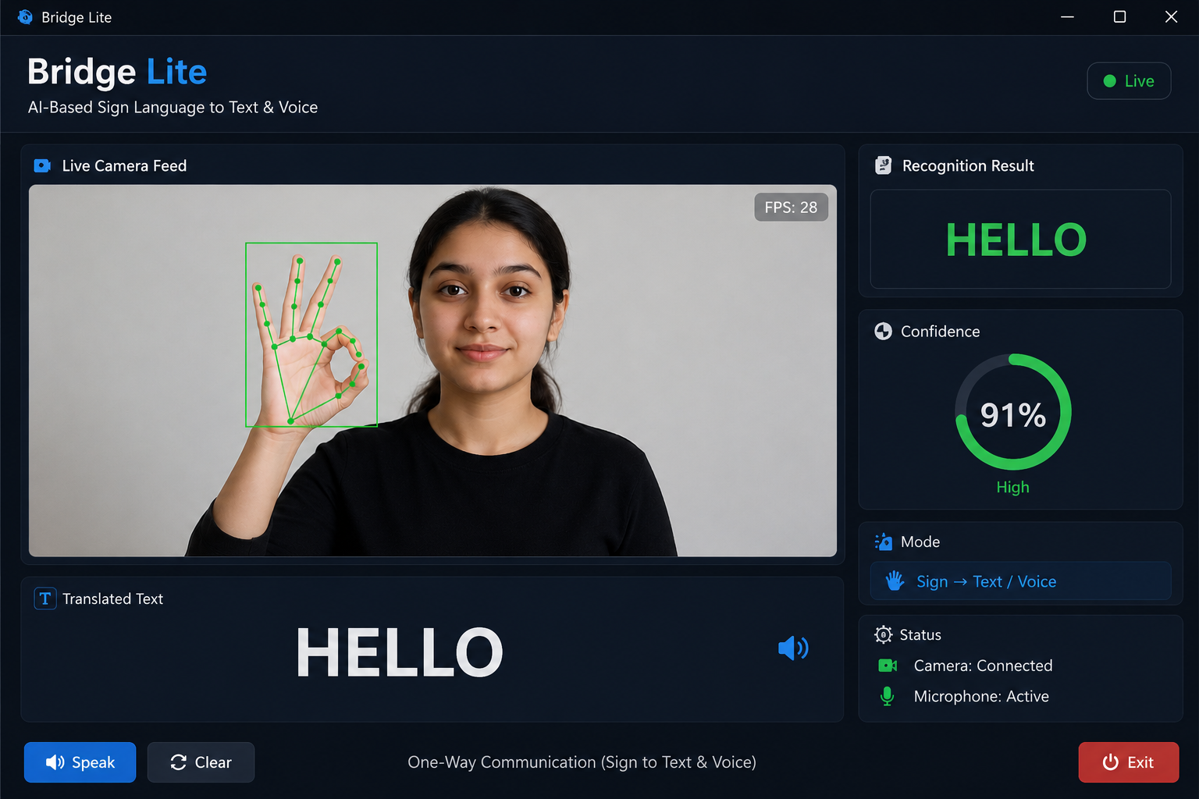

Slide 10
Advantages & Limitations
10
Advantages:
It enables real time communication.
It can assist during emergency situations.
It converts sign language into text & voice and vice versa.
Limitation:
Currently, system recognize limited number of gestures.
Need standardized ASL vocabulary and more reliable sign recognition.
Lighting, background, and hand visibility can affect recognition
BRIDGE LITE | AI-BASED SIGN LANGUAGE COMMUNICATION
10 / 12

Slide 11
Future Scope
11
Vocabulary
Improved recognition
Increase the gesture vocabulary.
Enhance model performance under different lighting conditions, backgrounds, and hand positions.
Pakistan Sign Language (PSL)
Multi-language
Develop a dedicated PSL dataset and train a model to recognize standardized Pakistani sign language.
Add multiple sign languages.
BRIDGE LITE | AI-BASED SIGN LANGUAGE COMMUNICATION
11 / 12

Slide 12
Conclusion / Thank You
12
Bridge Lite demonstrates how computer vision and custom machine learning can turn sign language into immediate text, voice, and alerts.
Thank you
Questions?
BRIDGE LITE | AI-BASED SIGN LANGUAGE COMMUNICATION
12 / 12

